Slide 1
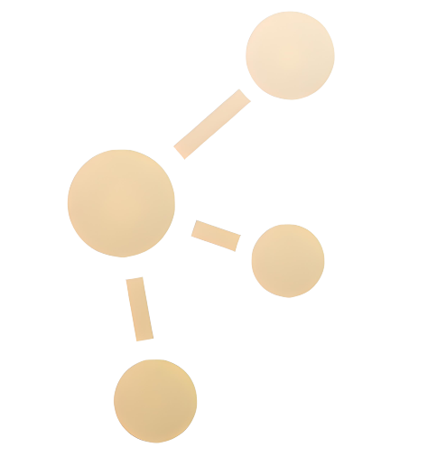
LiDAR-based Canopy Cover prediction
July 12th Update
Alejandro Donaire Èric Sánchez Pau Ventura

Slide 2
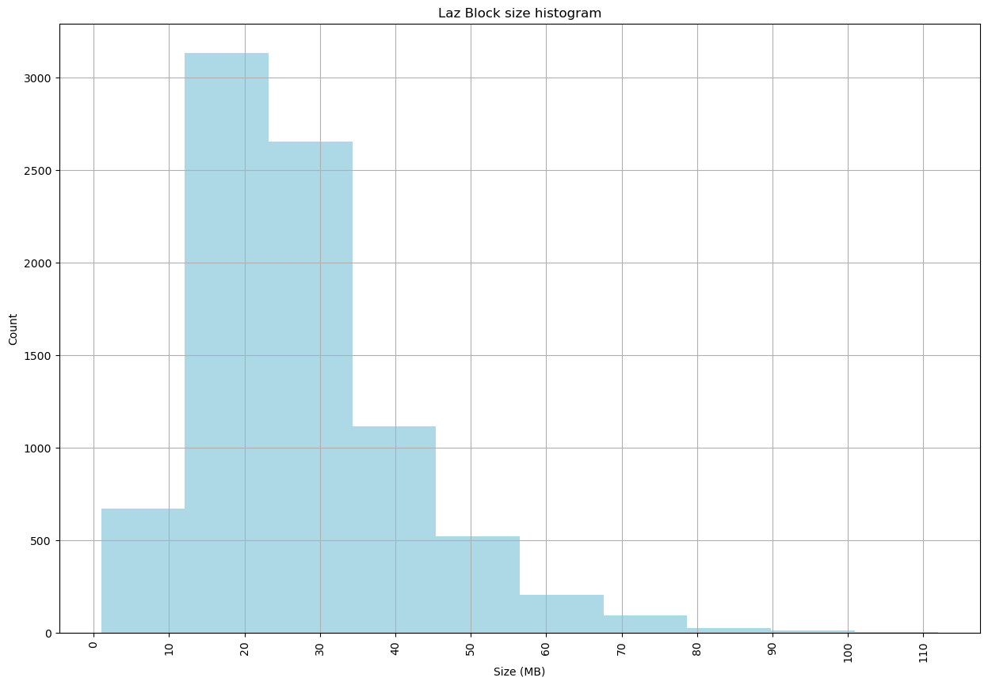
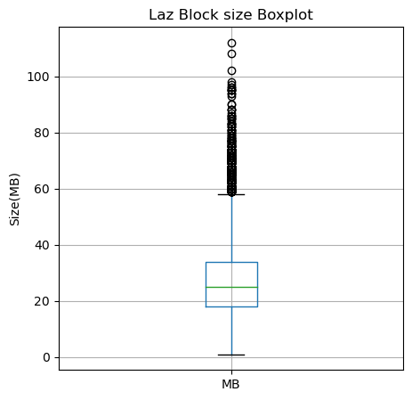
Blocksize Analysis
Total blocks: 8.434
30 MB -> 200 MB
(LAZ -> CSV)

Slide 3
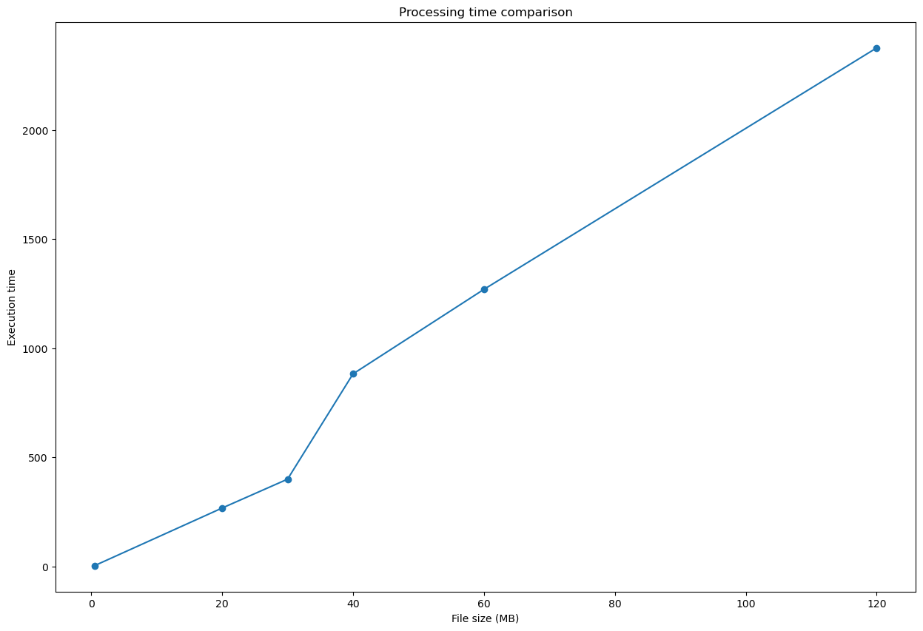
Block execution time comparison
Mean execution time:
~7-9 min (seq)

Slide 4
We are currently executing in the cluster! BANE NODE

Slide 5
Massive number of blocks upgrade
10 Train - 1 Test
115 Train - 29 test

Slide 6
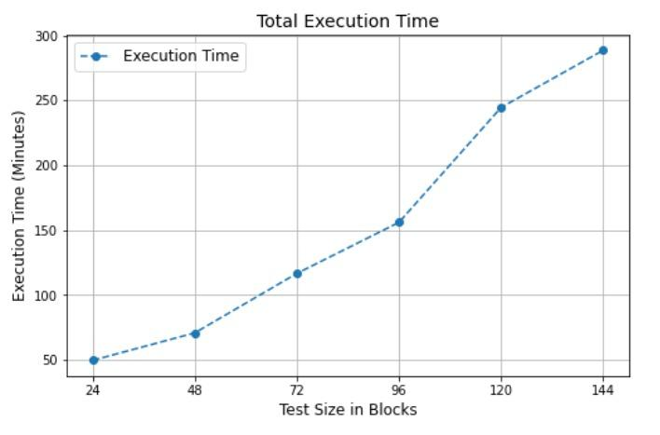
Metrics analysis - Time

Slide 7
Speed up and efficiency
Rough calculations:
→ 144 Blocks: 24 CPU vs Sequential:
4.5 Speed-Up
20% Efficiency

Slide 8
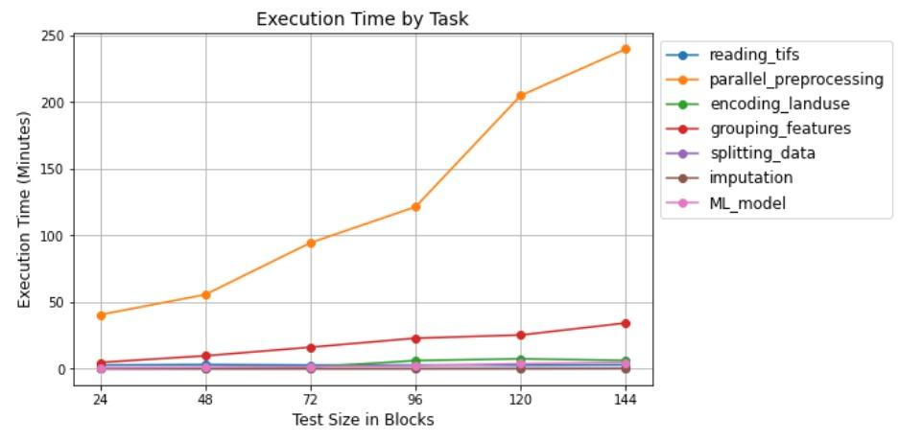
Metrics analysis - Time

Slide 9
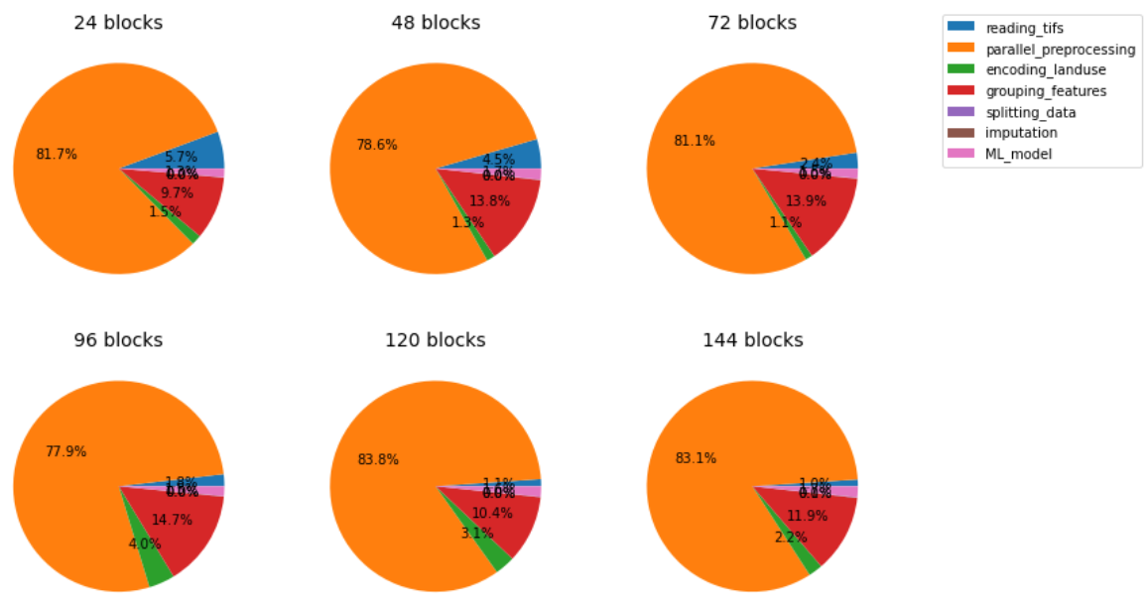
Metrics analysis - Time

Slide 10
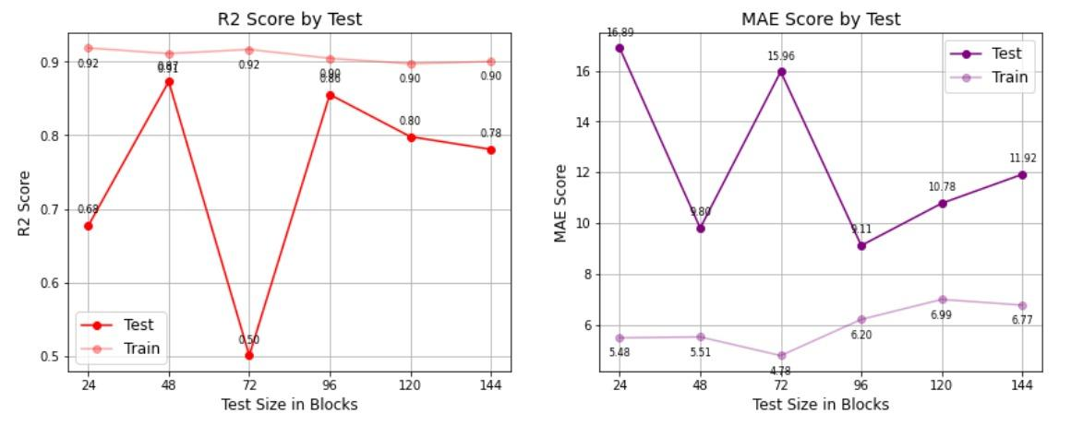
Metrics analysis - Scores

Slide 11
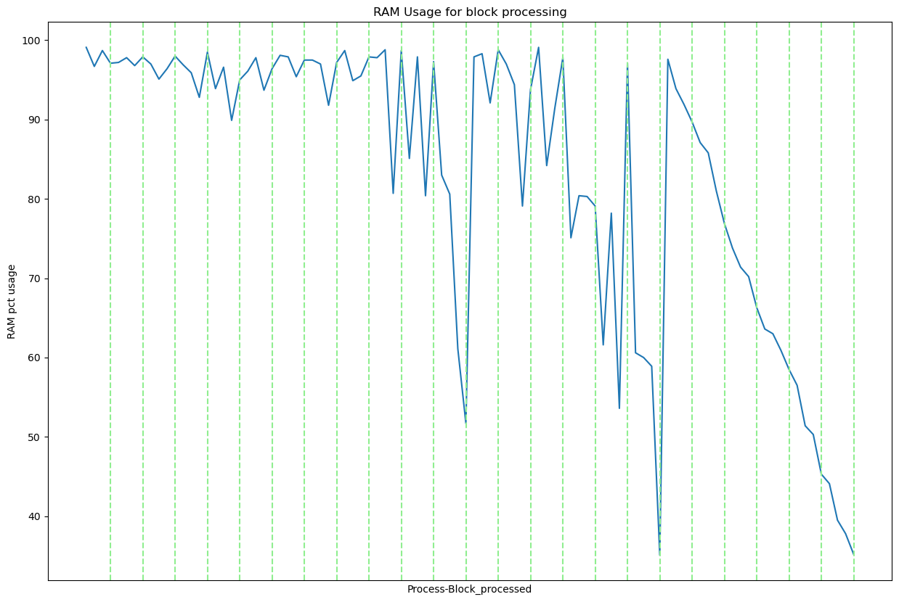
Metrics analysis - RAM

Slide 12

Python script, parallel-processing approach 2

Slide 13
Python script, parallel-processing approach 1

Slide 14
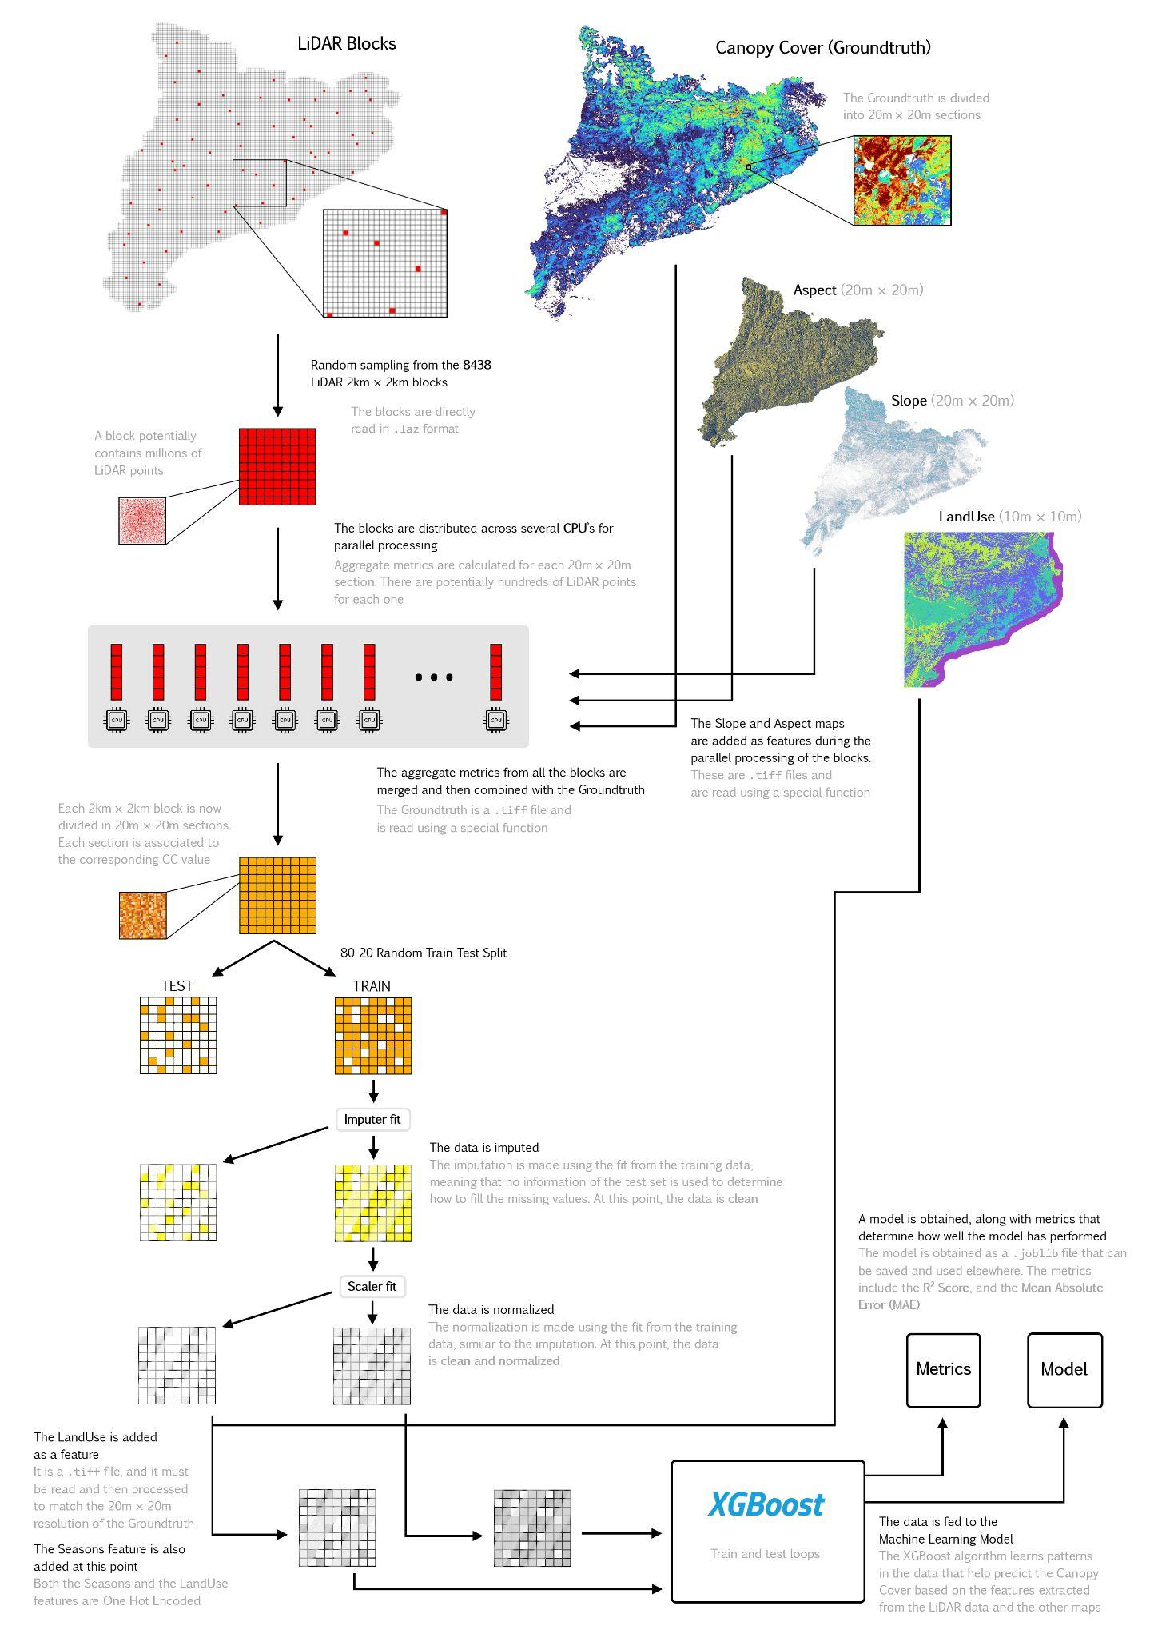
Big diagram of the full workflow

Slide 15
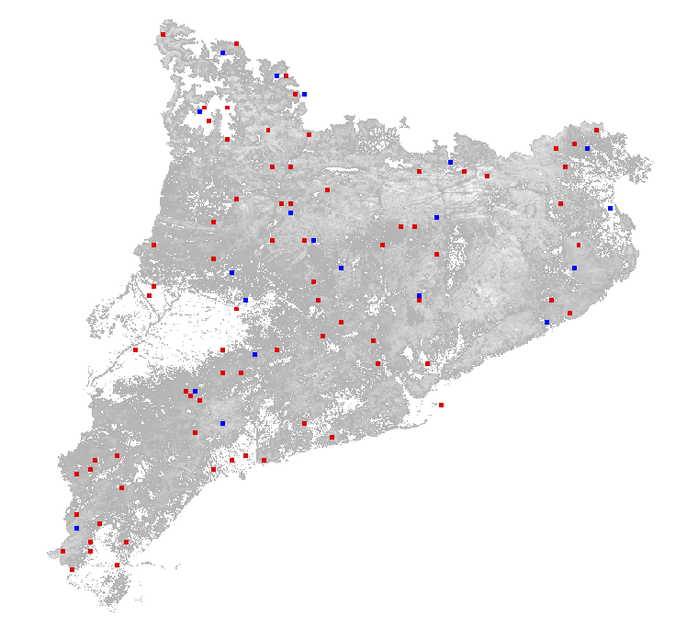
Now we can visualize which blocks have been chosen
Example: 72 block execution 58 train 14 test

Slide 16
Control blocks
METRICS AND PREDICTIONS

Slide 17
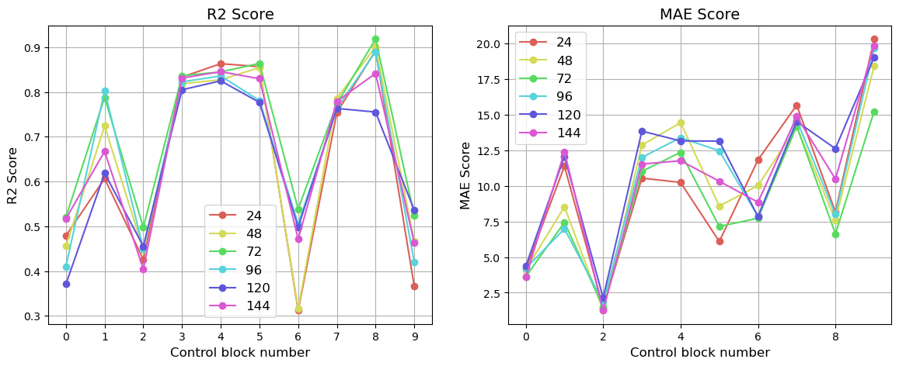
Metrics analysis - Control set - Scores

Slide 18
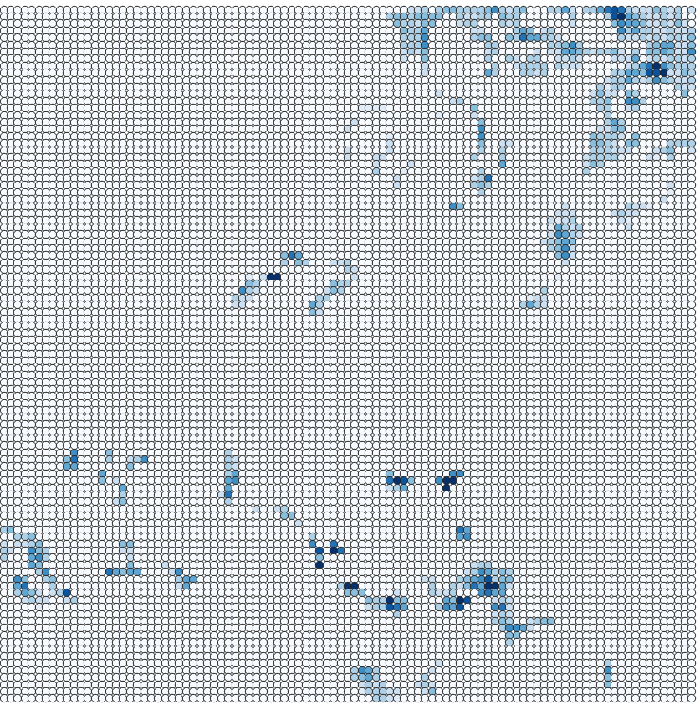
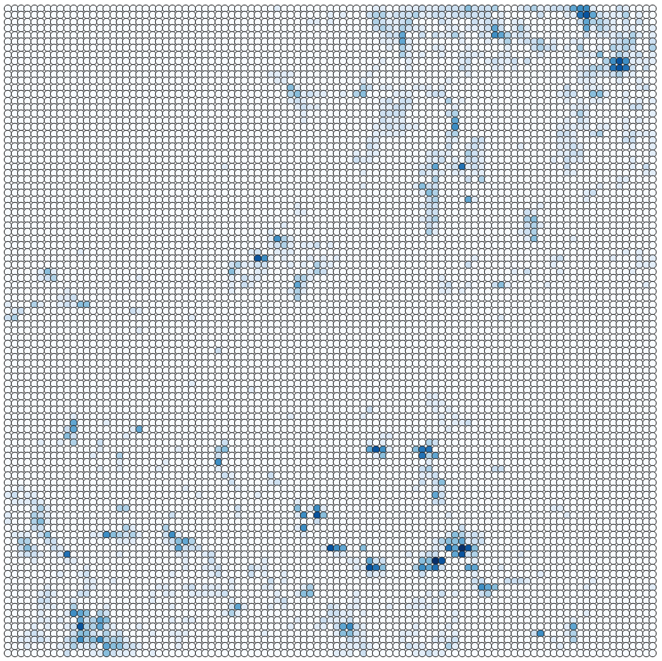
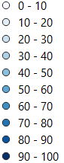
Predictions for control blocks (diverse10). Trained with 144*0.8 b.
3.5 MAE
REAL
PREDICTED
0.52 R²

Slide 19
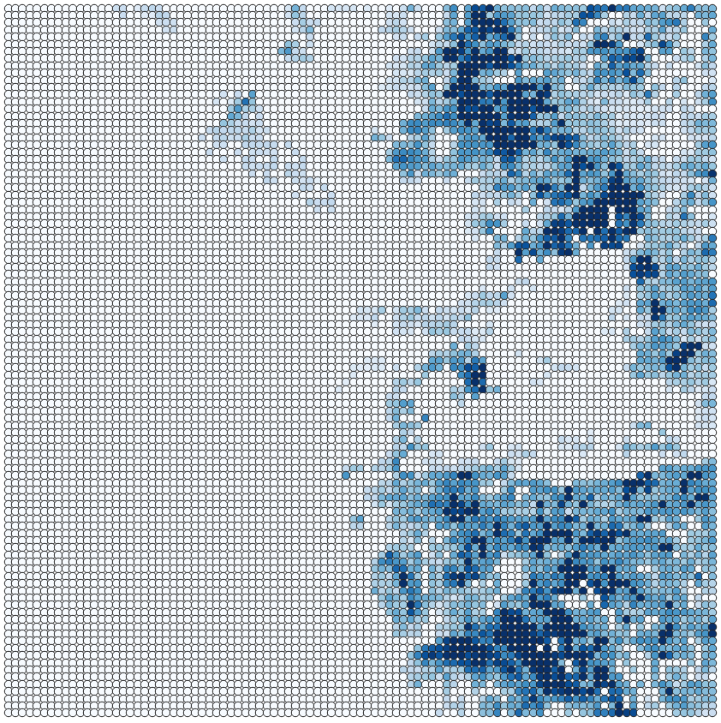
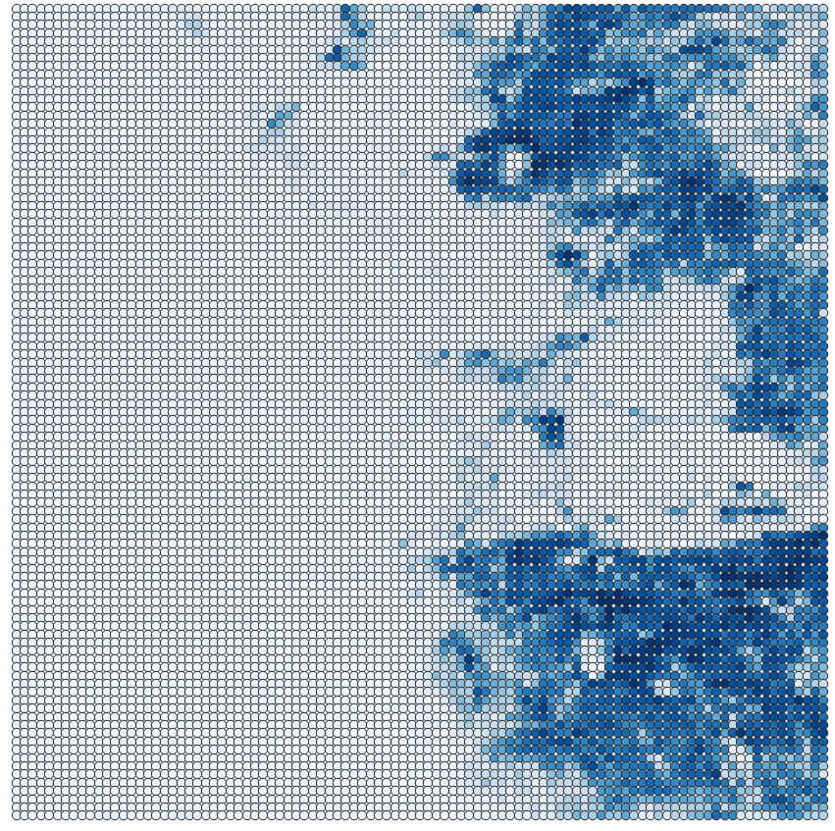
Predictions for control blocks (diverse10). Trained with 144*0.8 b.
12.5 MAE
REAL
PREDICTED
0.68 R²

Slide 20
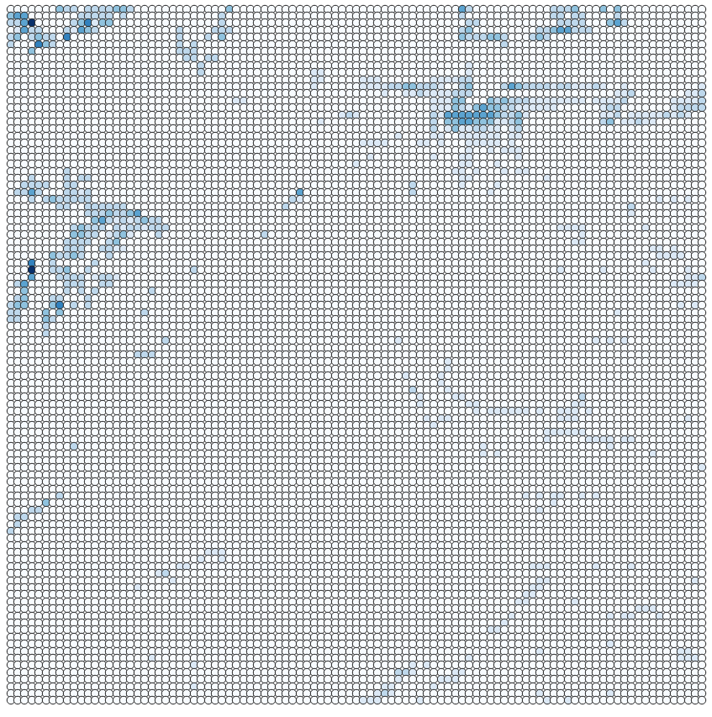
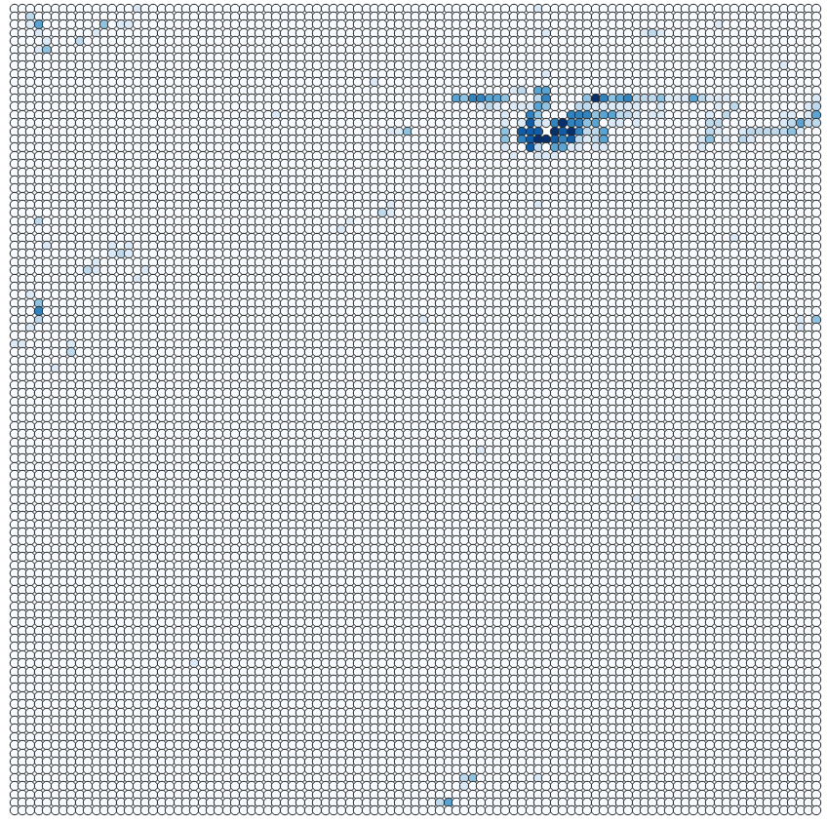
Predictions for control blocks (diverse10). Trained with 144*0.8 b.
1.5 MAE
REAL
PREDICTED
0.4 R²

Slide 21
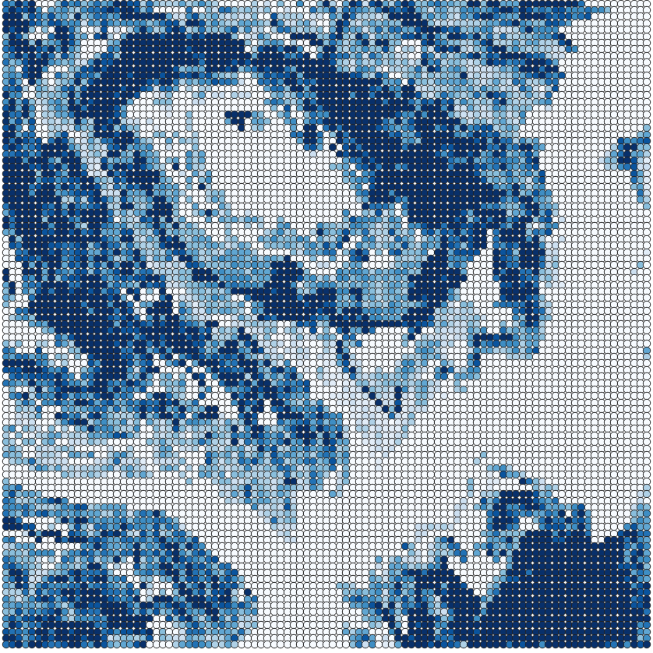
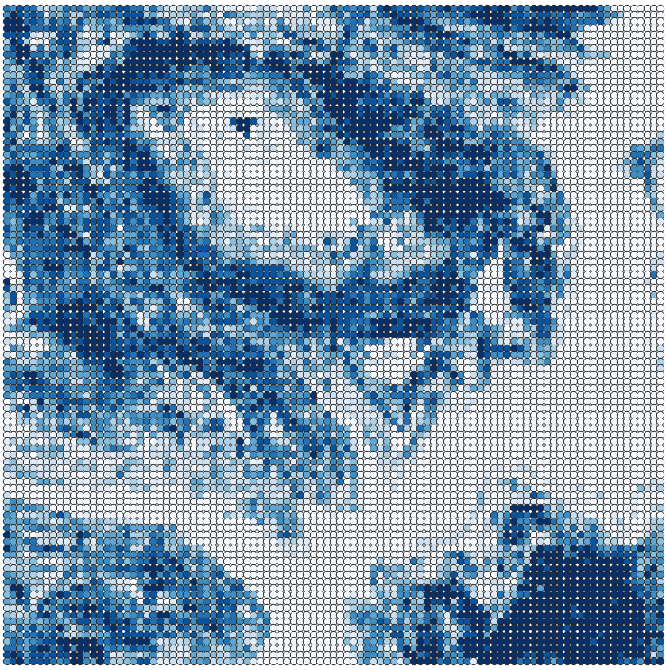
Predictions for control blocks (diverse10). Trained with 144*0.8 b.
11.5 MAE
REAL
PREDICTED
0.83 R²

Slide 22
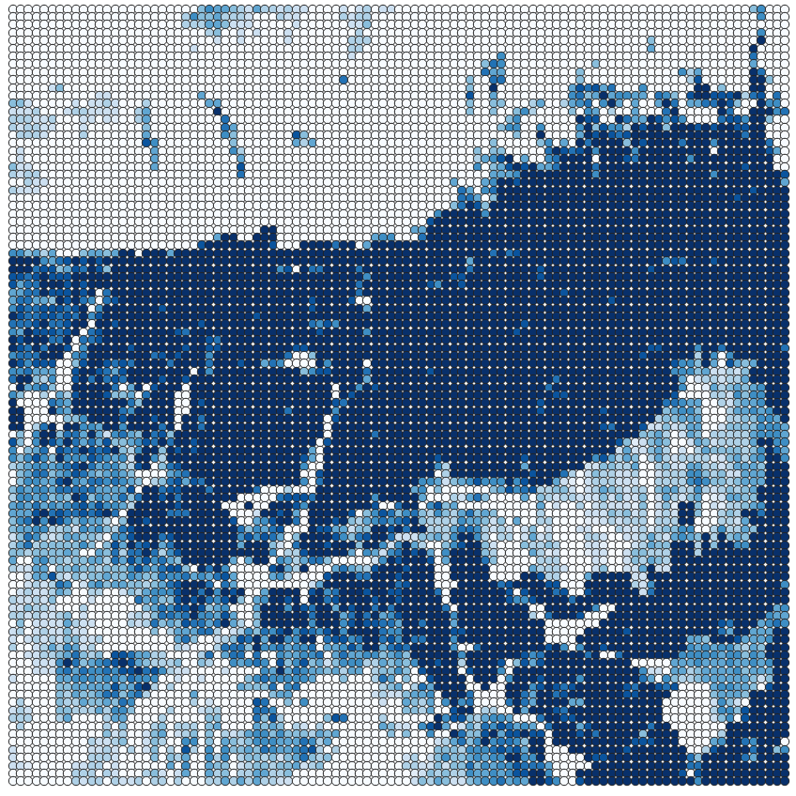
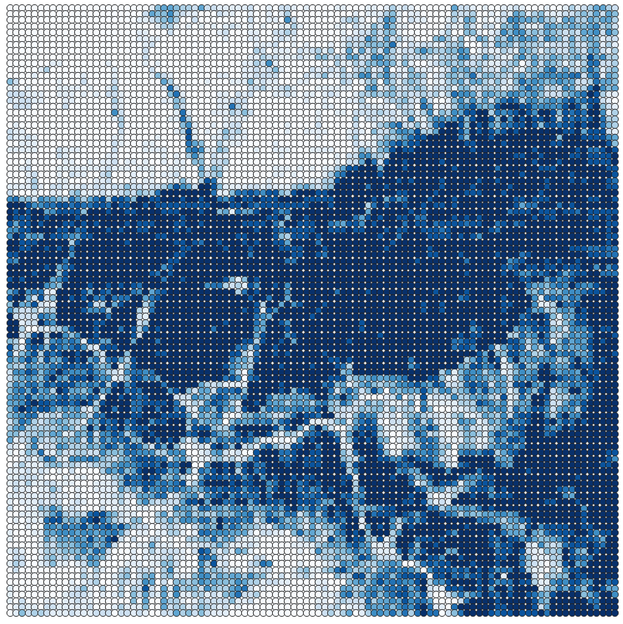
Predictions for control blocks (diverse10). Trained with 144*0.8 b.
12 MAE
REAL
PREDICTED
0.84 R²

Slide 23
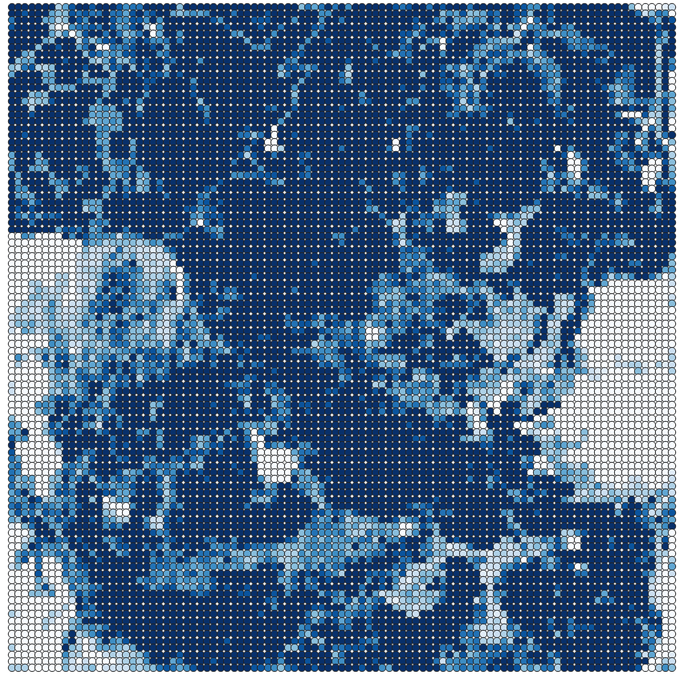
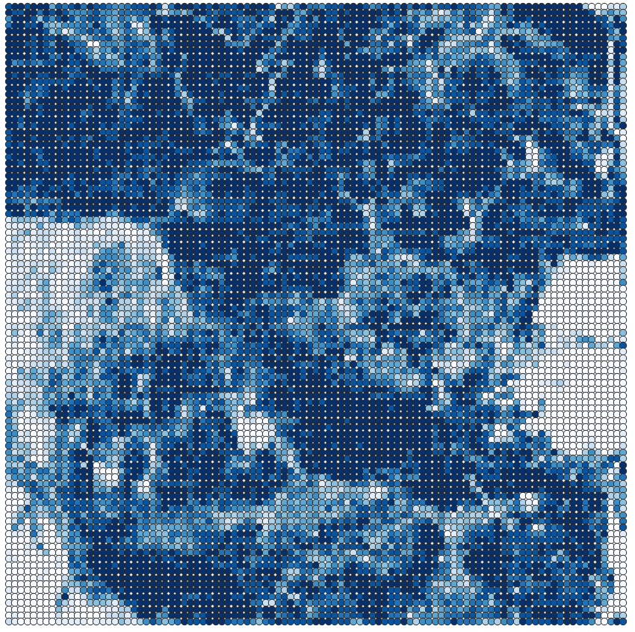
Predictions for control blocks (diverse10). Trained with 144*0.8 b.
10.5 MAE
REAL
PREDICTED
0.83 R²

Slide 24
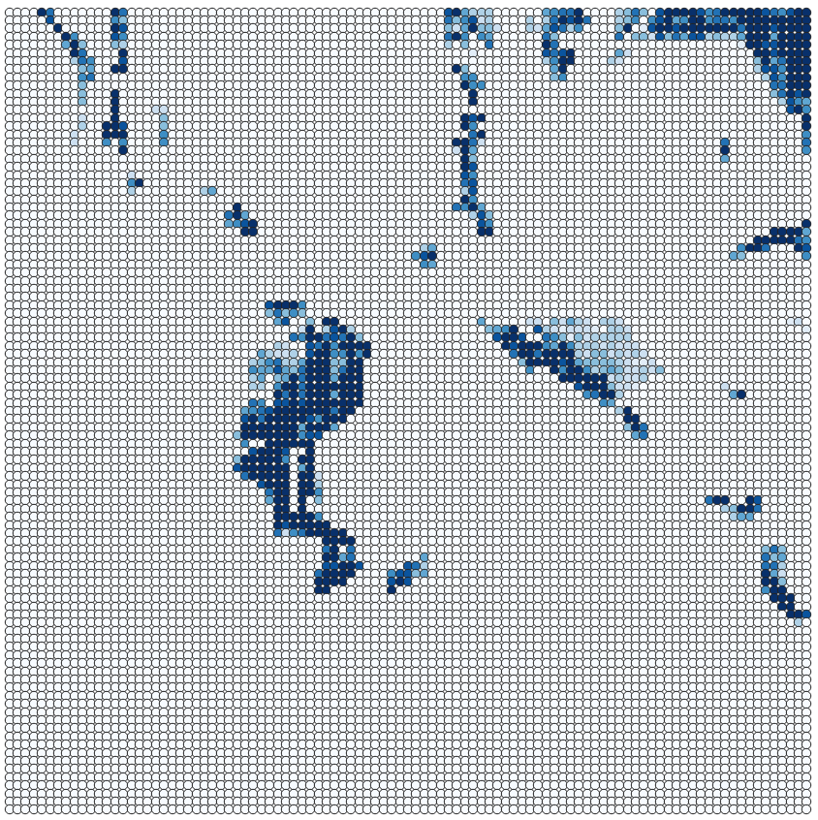
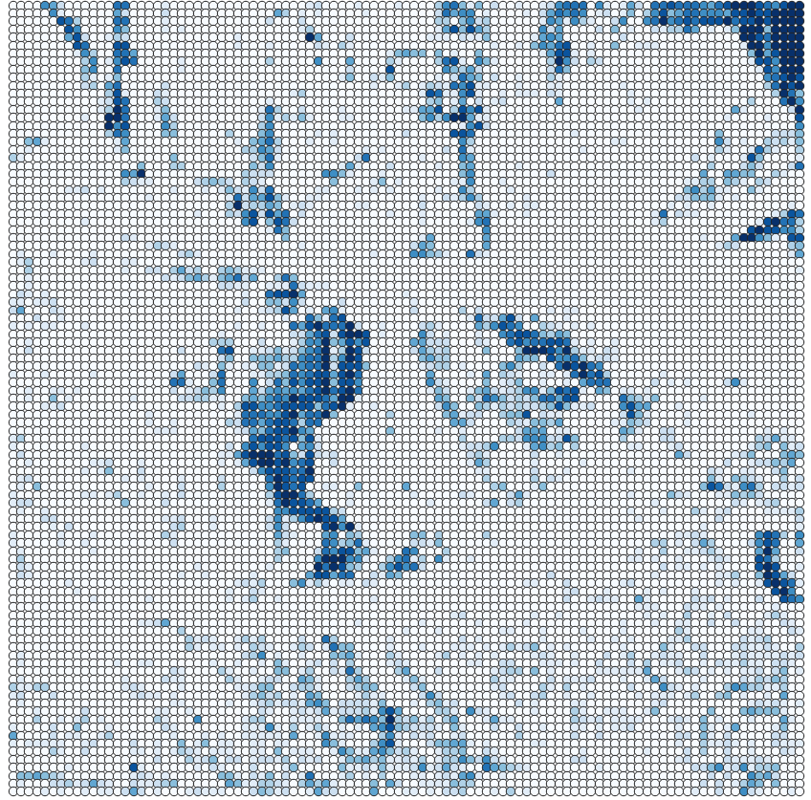
Predictions for control blocks (diverse10). Trained with 144*0.8 b.
8.5 MAE
REAL
PREDICTED
0.48 R²

Slide 25
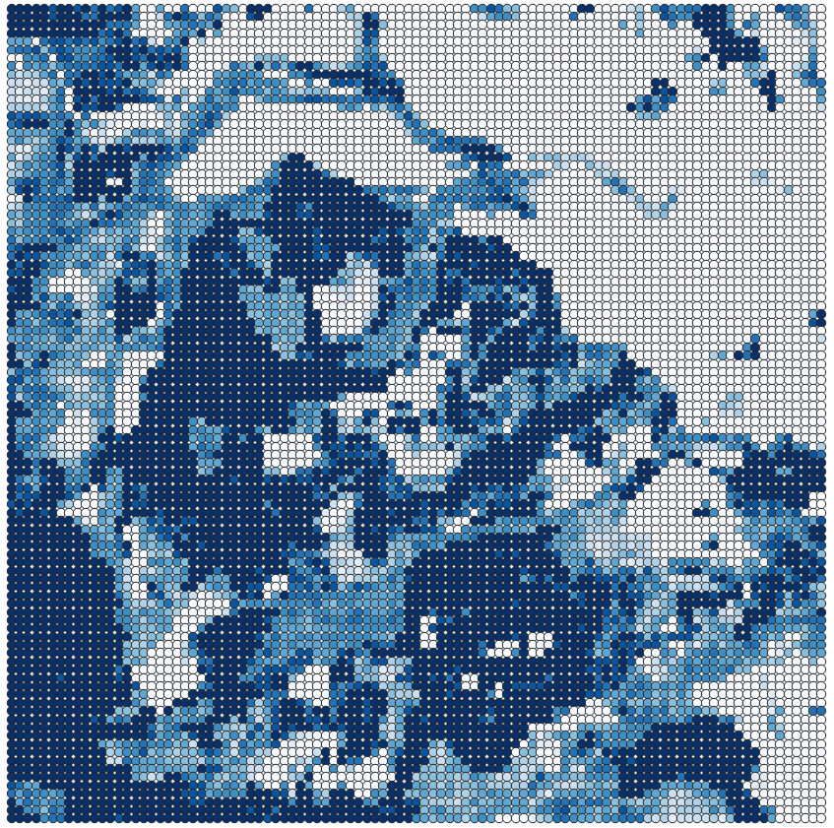
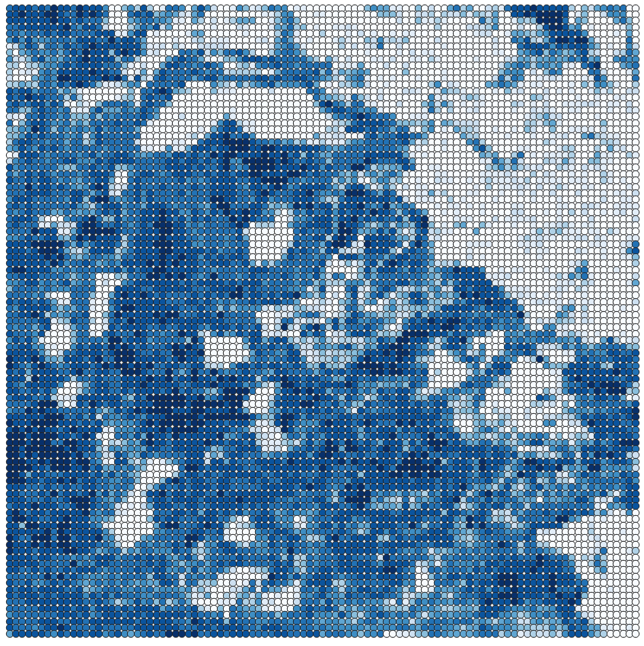
Predictions for control blocks (diverse10). Trained with 144*0.8 b.
8.5 MAE
REAL
PREDICTED
0.48 R²

Slide 26
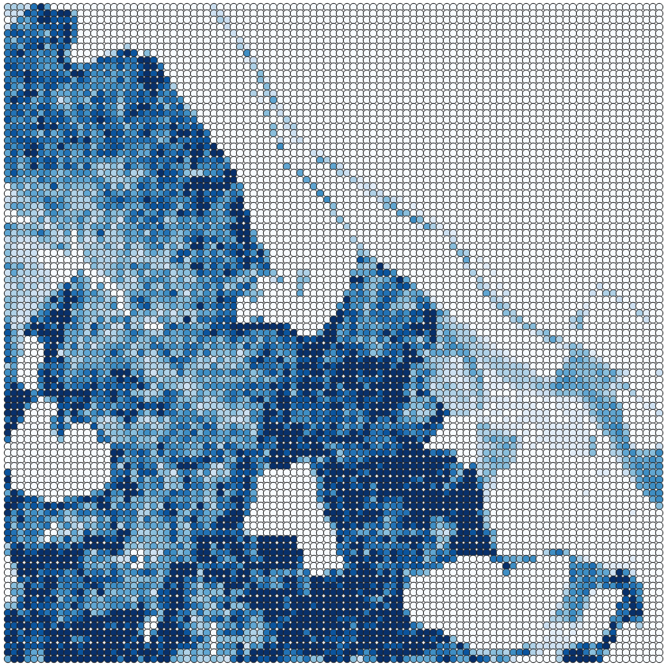
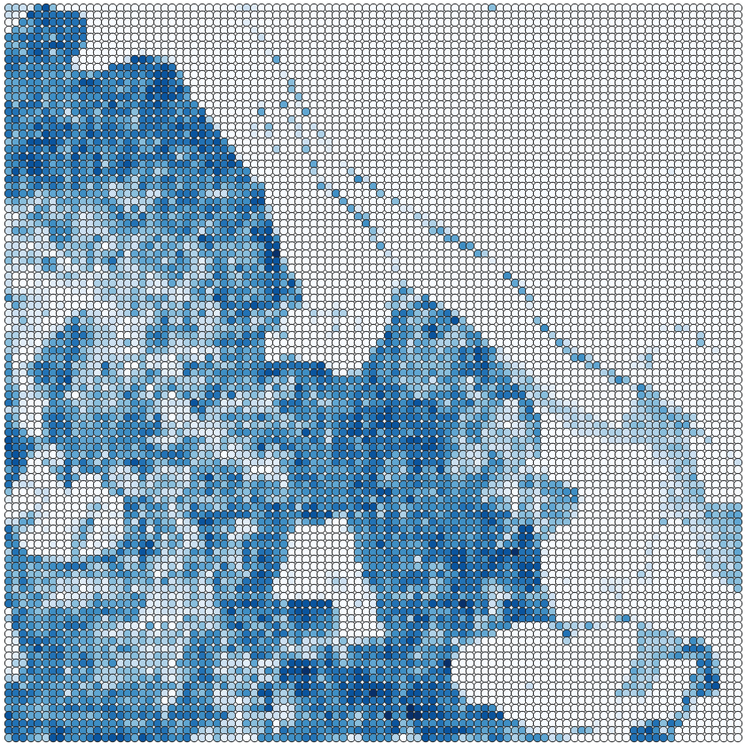
Predictions for control blocks (diverse10). Trained with 144*0.8 b.
15 MAE
REAL
PREDICTED
0.84 R²

Slide 27
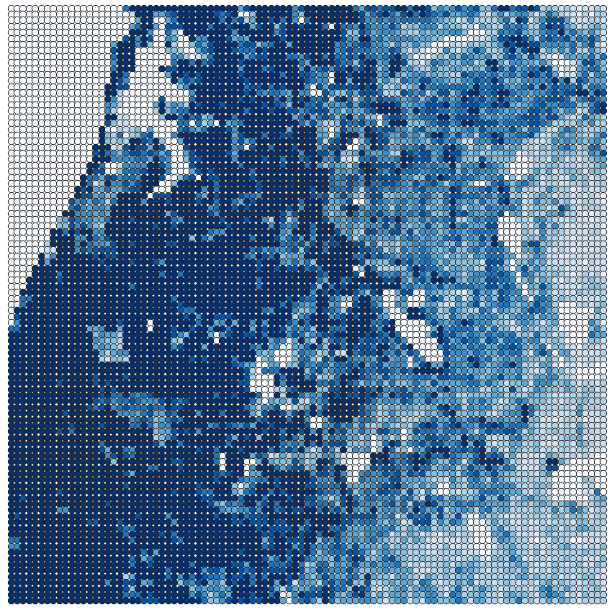
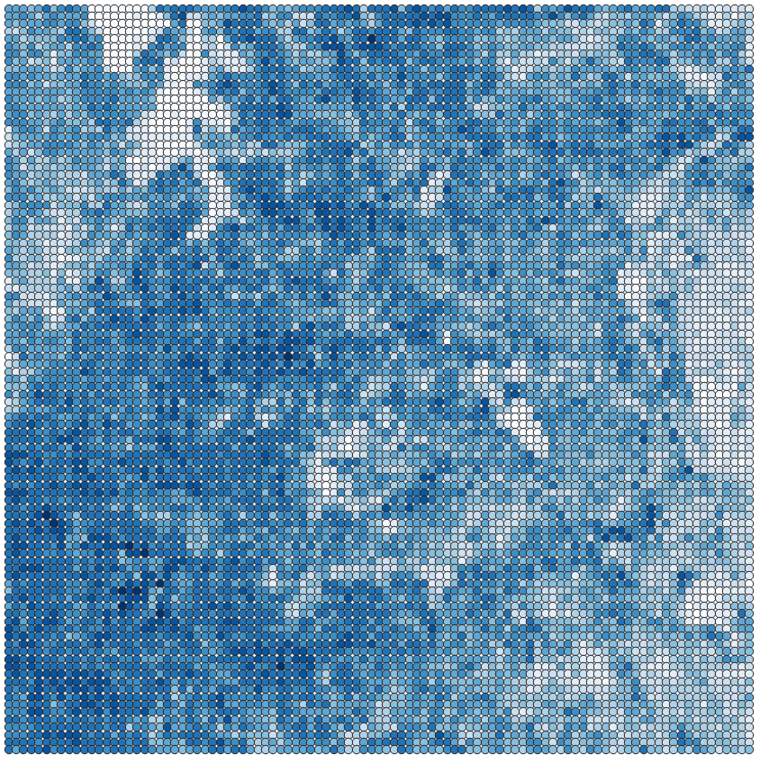
Predictions for control blocks (diverse10). Trained with 144*0.8 b.
10.5 MAE
REAL
PREDICTED
0.48 R²

Slide 28
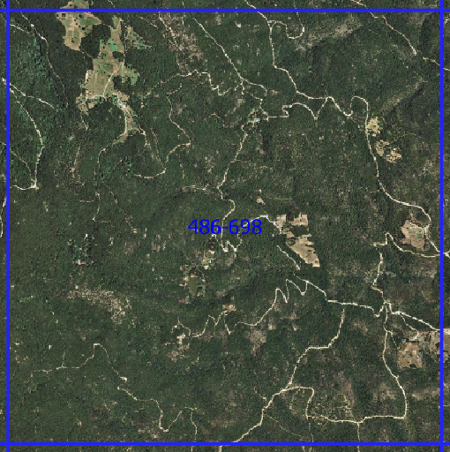
Predictions for control blocks (diverse10). Trained with 144*0.8 b.
MAP
PREDICTED

Slide 29
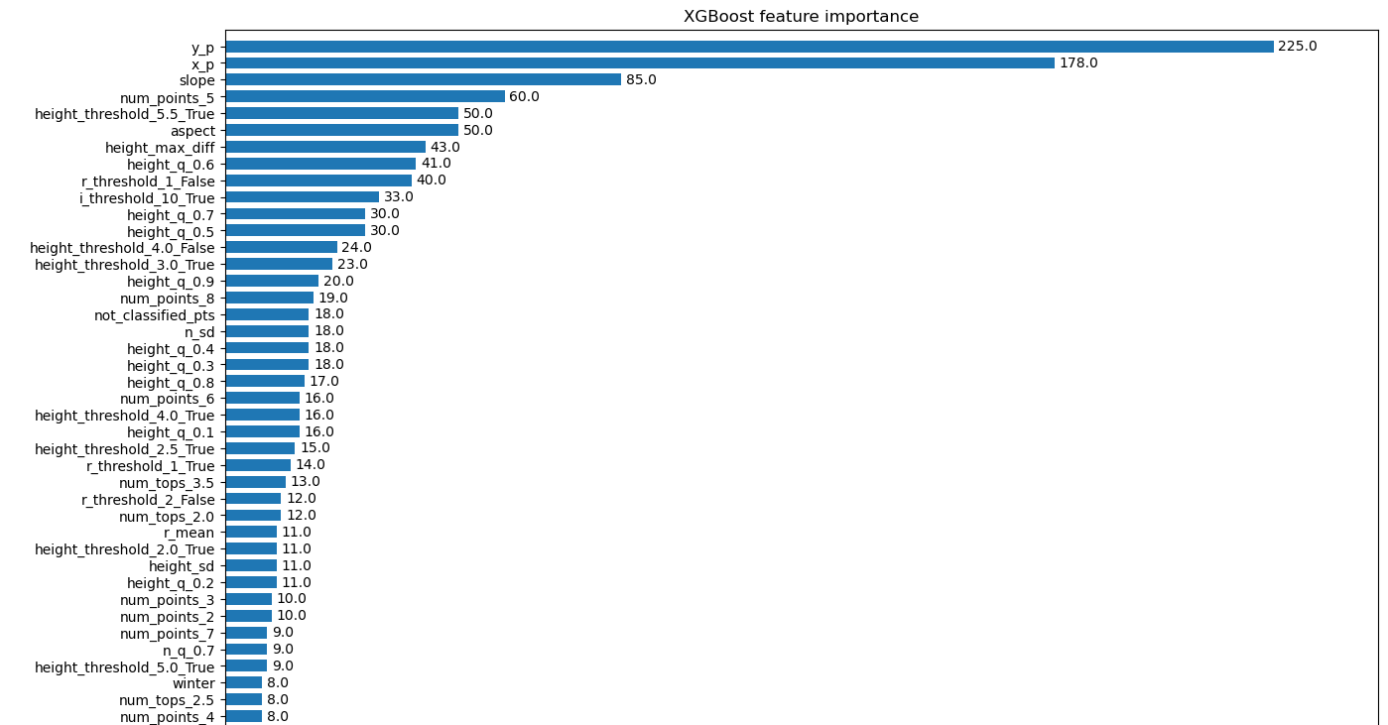
Feature Importance (144 blocks)

Slide 30
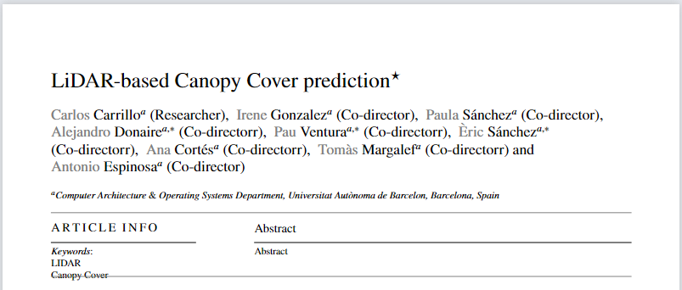
Article
Started writing the article: basic layout and some references.

Slide 31
Next week
Keep training with more blocks
Try to optimize the memory usage and execution time
Keep track of the metrics and ponder about them
Visualize in a more professional way the predictions
Decide whether to do Feature Selection, PCA and Hyperparameter Search
Continue writing the document

